Slide 1

Notes:
open with the hook. hand them the one-pager now, not later.

Slide 2
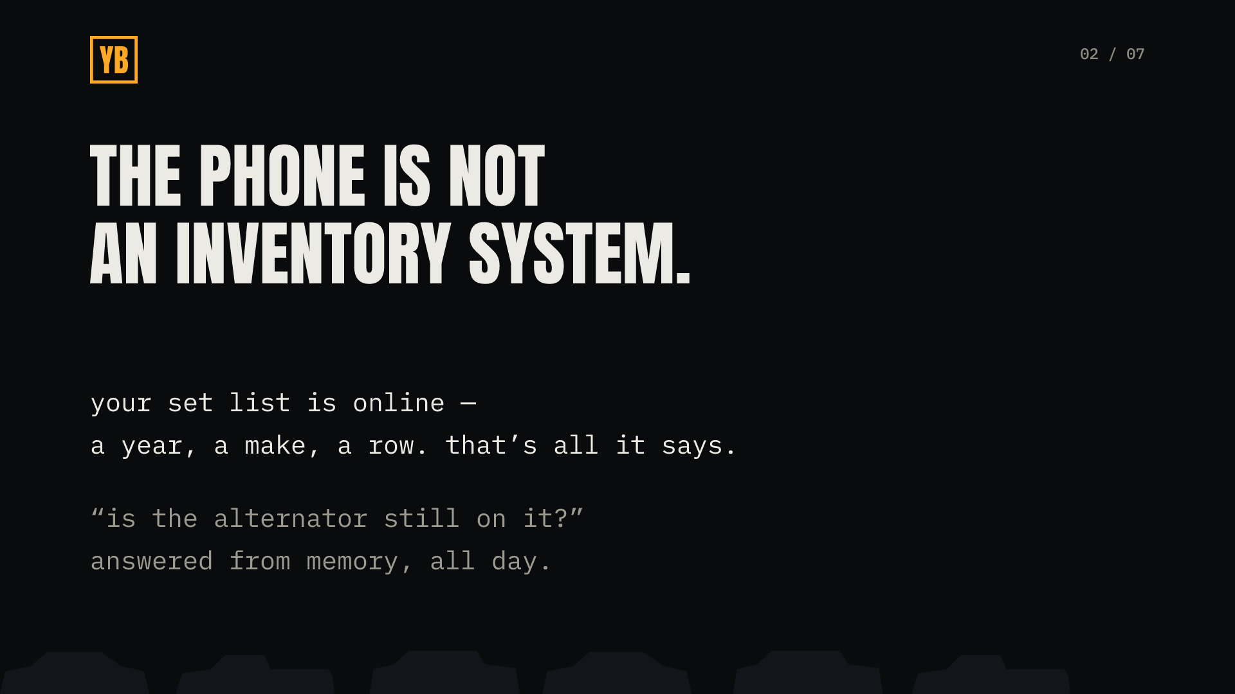
Notes:
let them tell their own phone stories — they will.

Slide 3
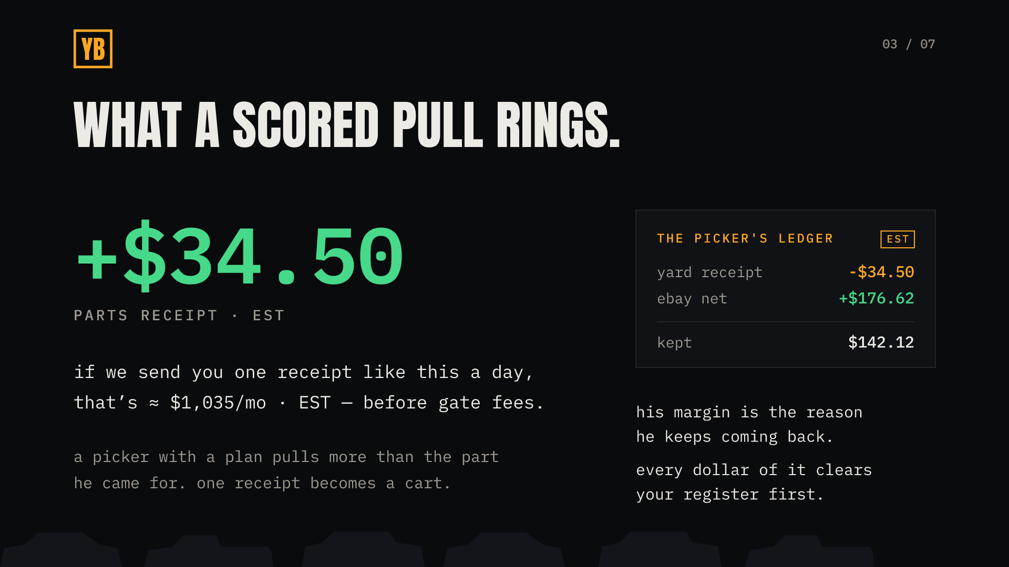
Notes:
both sides on purpose: let him find the $176 himself, then hand him the reframe — every dollar of it clears your register first. say EST out loud.

Slide 4
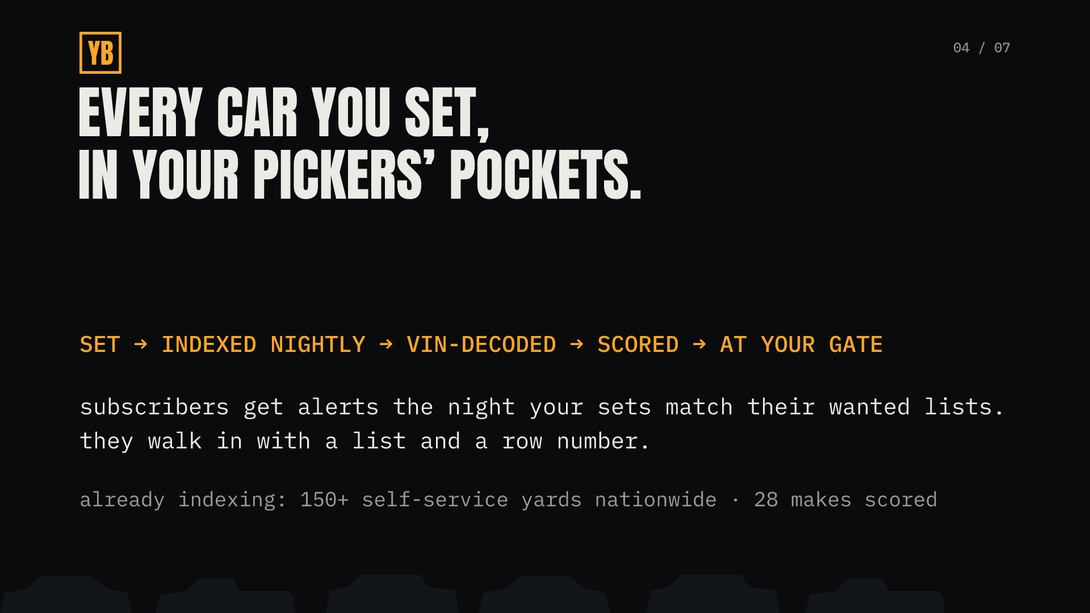
Notes:
alerts are the foot-traffic mechanism: tuesday set, wednesday gate line. nightly cadence — do not oversell as real-time.

Slide 5

Notes:
if they are on the roster, pull up their actual lot page live. the card is marked SAMPLE — say so.

Slide 6
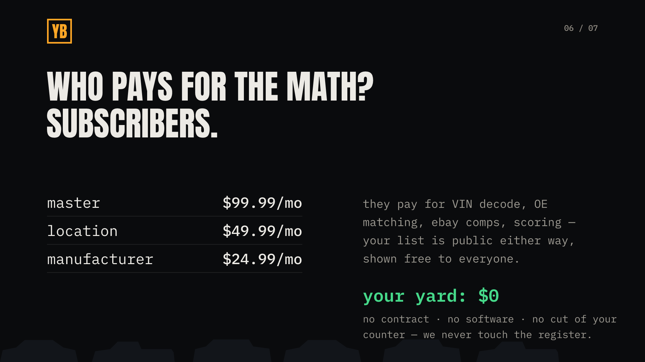
Notes:
the objection lands here: you profit off my inventory. answer: the list is public either way; subscribers pay for the math; no cut of the counter.

Slide 7
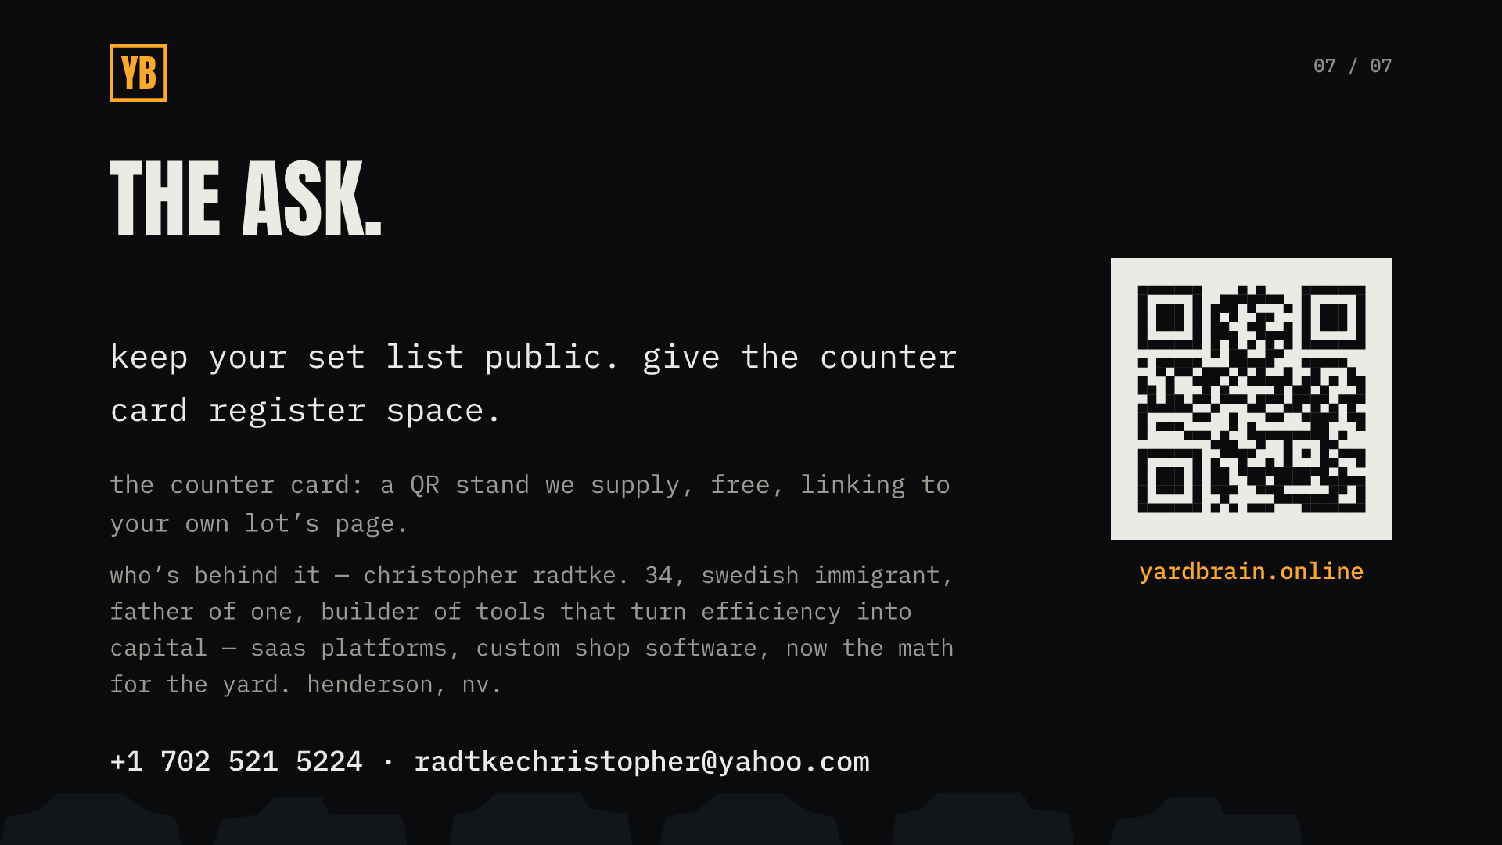
+1 702 521 5224 · radtkechristopher@yahoo.com
Notes:
leave the tri-fold. ask for the counter spot on the way out — the card is free, we supply it.

